Slide 1
Strategic Sabotage and Crisis Bargaining
Zhejun
Qiu
William Spaniel
Christopher
Hickey

Slide 2

Strategic Sabotage and Crisis Bargaining
William Spaniel
Christopher
Hickey
Zhejun
Qiu
Notes:
Zhejun, third year grad student, did the bulk of the modeling work

Slide 3
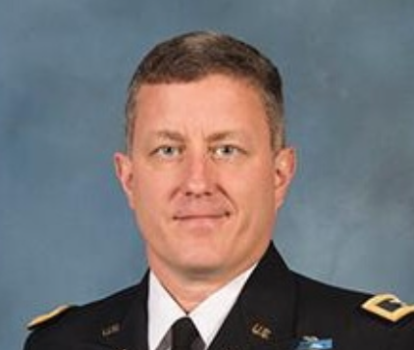
Strategic Sabotage and Crisis Bargaining
William Spaniel
Zhejun
Qiu
Christopher
Hickey
Notes:
Christopher Hickey, Colonel, professor at the Army War College, did a deep dive in the military history

Slide 4

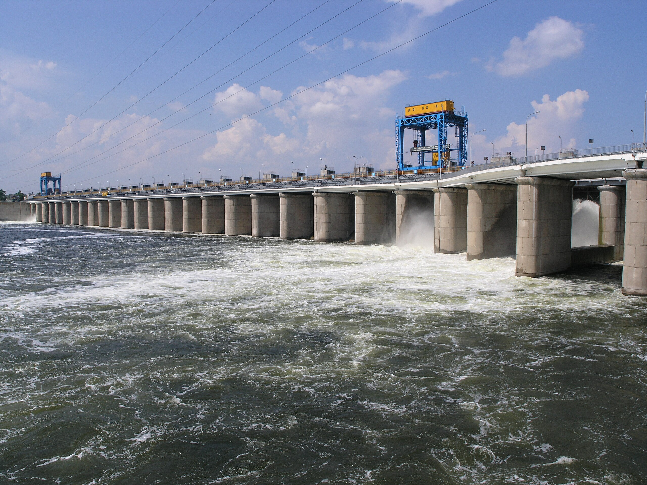
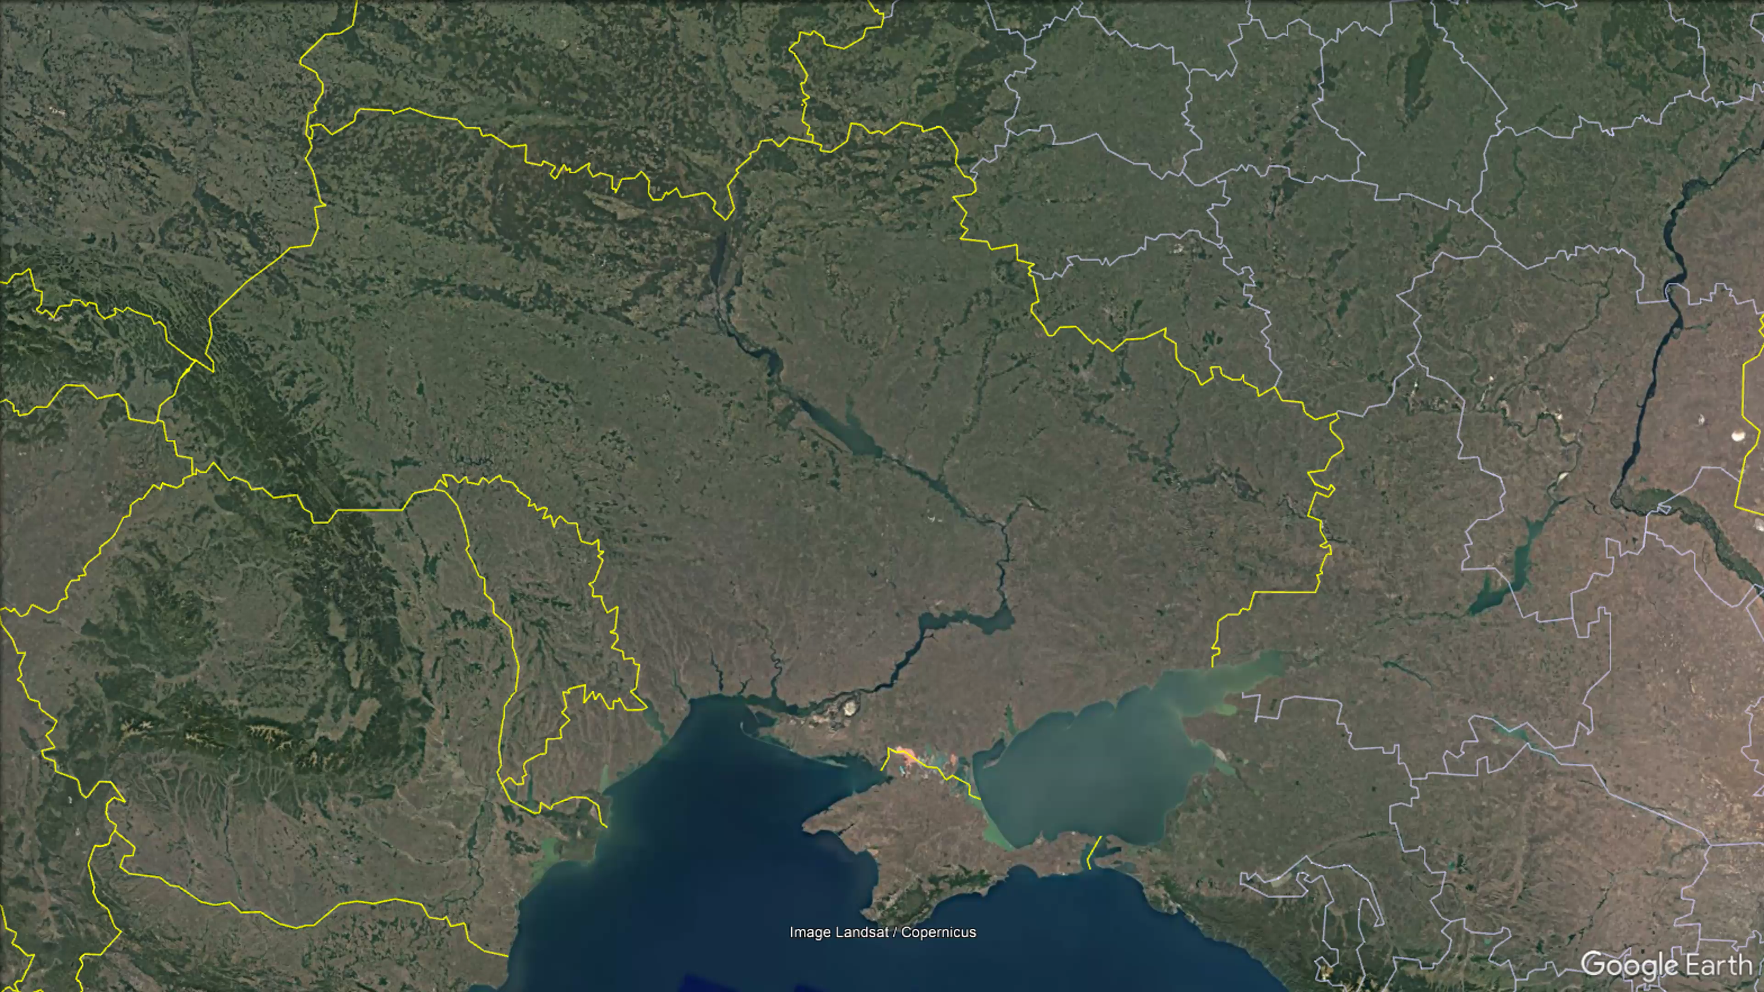
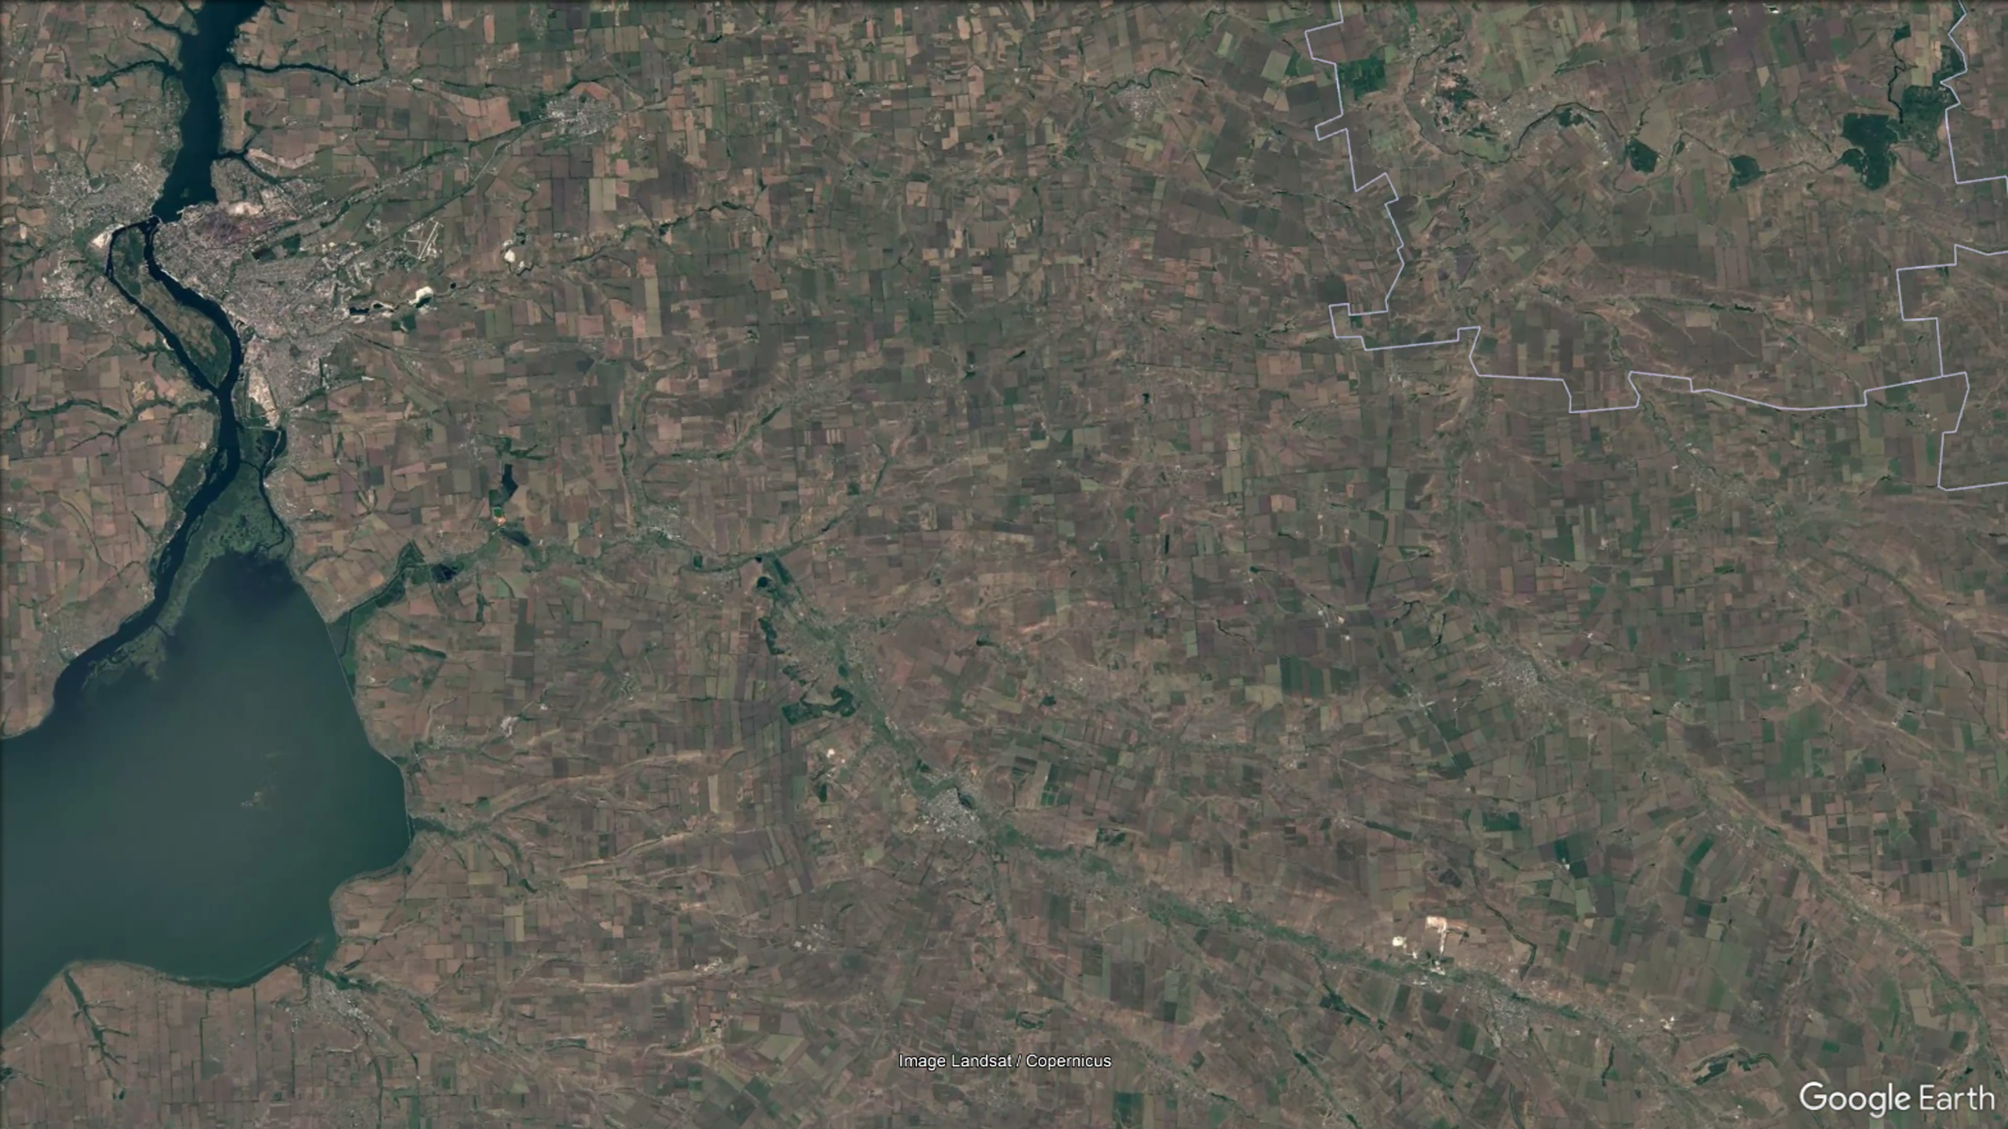
June 5, 2023
Notes:
Ukraine starts its offensive
Interesting thing happens further southeast
Western intelligence assessment is that Russia blew it up from the inside

Slide 5
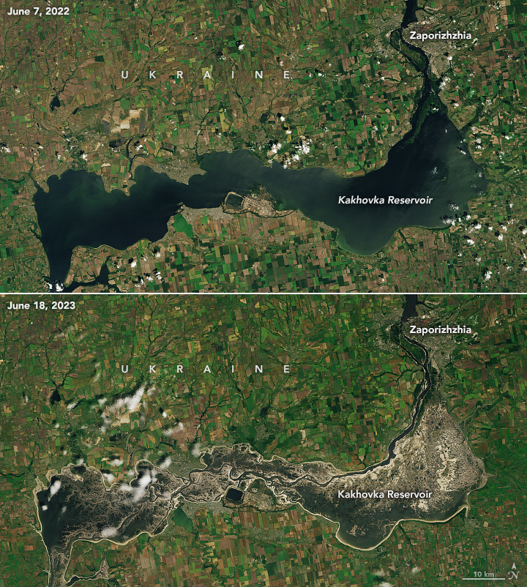
Notes:
Huge backflow of water behind the dam drained

Slide 6
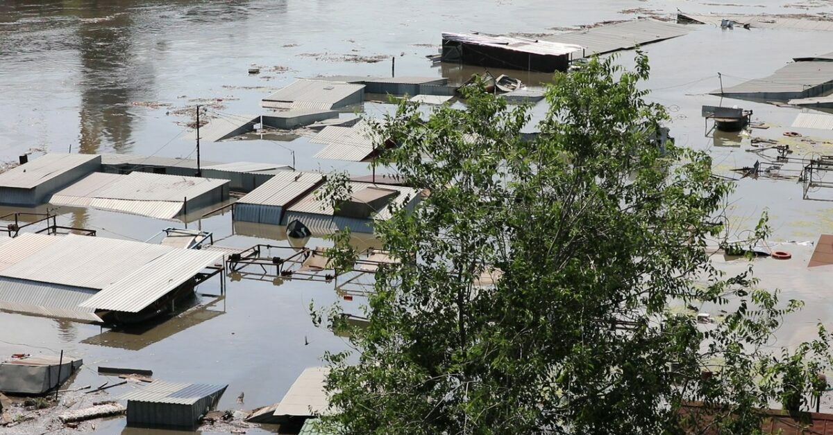
Notes:
Environmental catastrophe

Slide 7


Notes:
Russian troops defending the area behind the river, which formed the front line

Slide 8
Notes:
Redeploy here and fight the counteroffensive.
Largely interpreted as Russian weakness.

Slide 9
Two Main Effects
Increase perpetrator's ability to win
Cost only suffered by winner

Slide 10
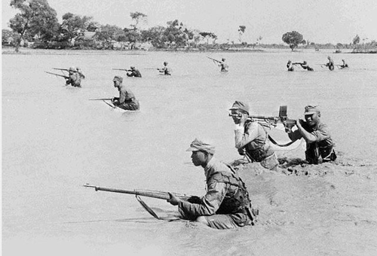
Notes:
1938, China blows Yellow River dam to slow Japanese advance

Slide 11
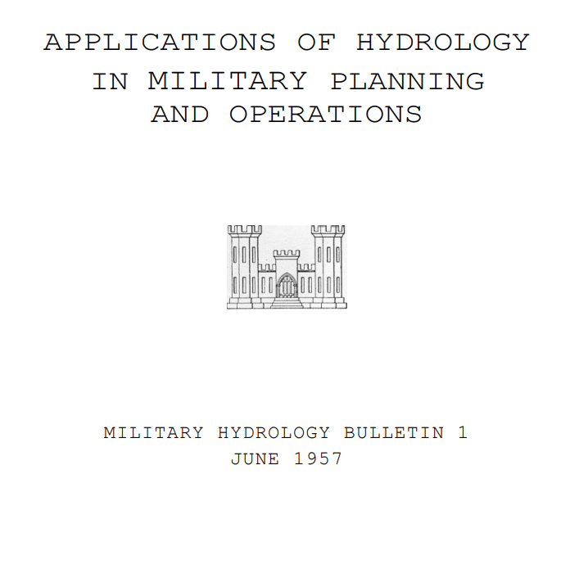
Notes:
Army has a manual on Hydraulic Warfare

Slide 12
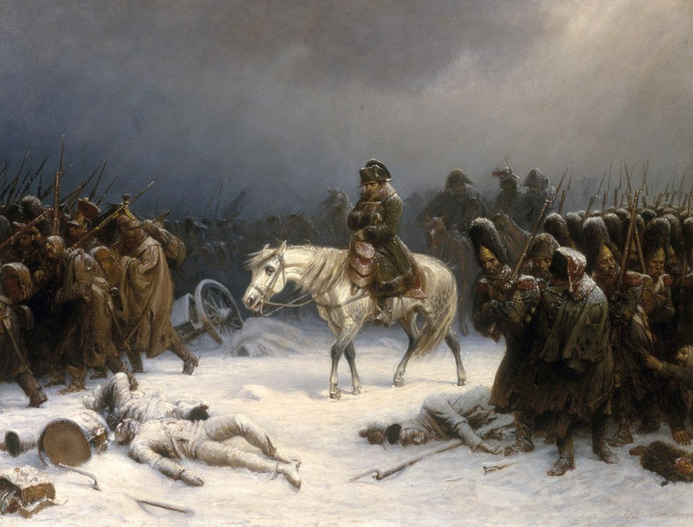
Notes:
Russia scorched earth policy, both during Napoleonic Era and World War II
(PD)

Slide 13
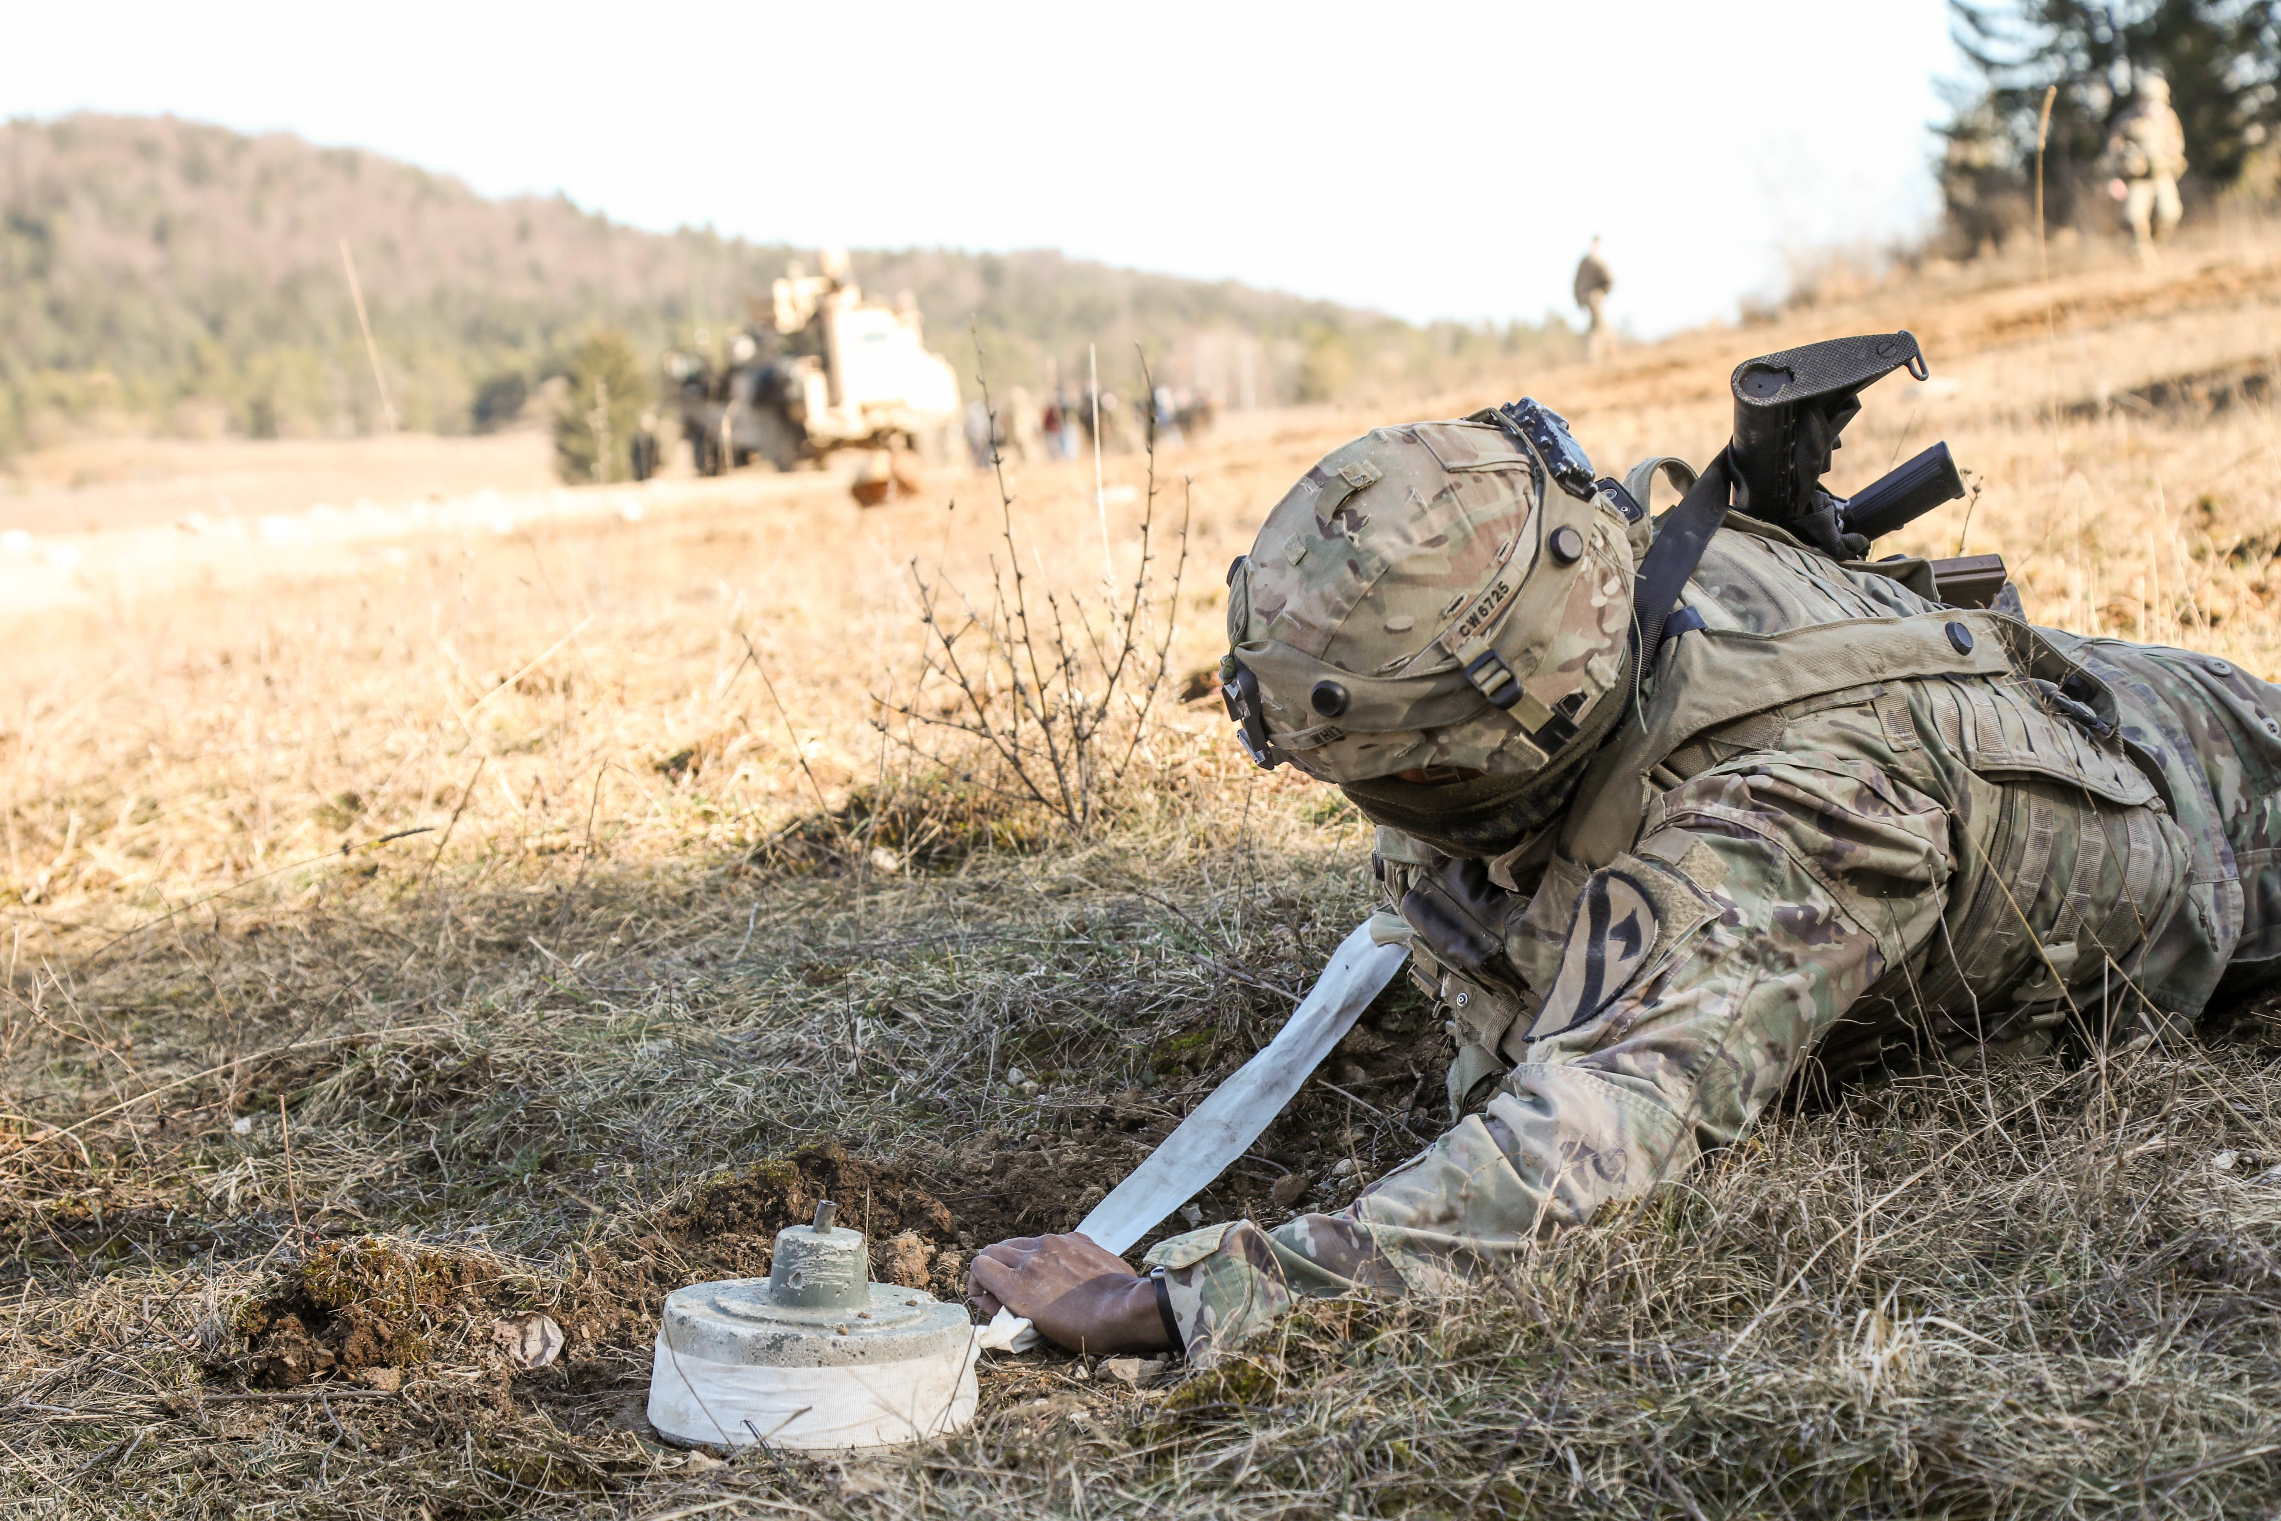
Notes:
Mine fields
Hard to find a war where nothing like this happens

Slide 14
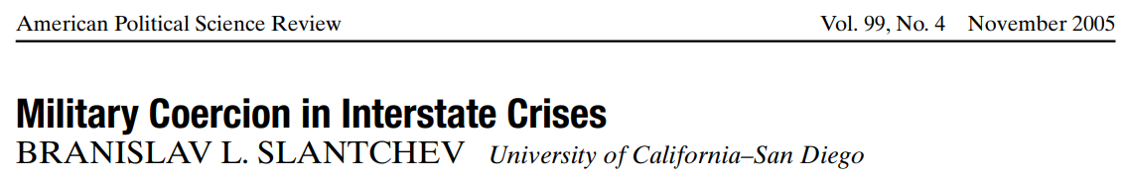
Notes:
Many models where a cost is paid to increase chances of victory, but they are sunk costs, not socialized costs weighed by chances of winning.

Slide 15
What Happens?
Complete Information Model
Basic cost-benefit decision, more attractive for weaker states
Incomplete Information Model
Weaker types may be more likely to sabotage
Separating equilibria fail to exist for standard uncertainty
Shifting Power Commitment Problem Model
Sabotage can resolve commitment problems
Sabotage may be welfare improving

Slide 16
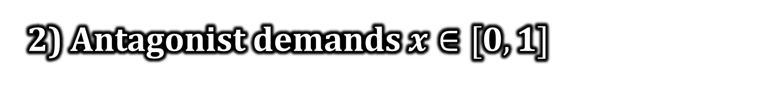
Complete Information
1) Saboteur chooses to sabotage or not
2) Antagonist demands $x∈[0, 1]$
3) Saboteur accepts or rejects

Slide 17

Complete Information
Without Sabotage
With Sabotage
Value of the good is 1
Value of the good is $π∈(0,1)$
Antagonist wins with probability p(0)
Antagonist wins with probability p(1)
Both sides pay war costs
Both sides pay war costs

Slide 18
Destructiveness of Sabotage
Saboteur’s Baseline Probability of Victory

Slide 19
No Sabotage
Destructiveness of Sabotage
Sabotage
Saboteur’s Baseline Probability of Victory
Notes:
Intuition: more destructive, less attractive. Obviously.
Subtly: Naturally more powerful, less attractive. Cost incurred by winner. If you likely to win without, then you are the one incurring most of the loss to get a little bit more of the good.

Slide 20

Complete Information
1) Saboteur chooses to sabotage or not
2) Antagonist demands $x∈[0, 1]$
3) Saboteur accepts or rejects

Slide 21
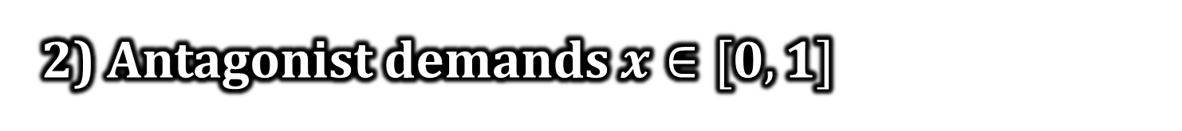
Incomplete Information
0) Nature chooses S as weak or strong
1) Saboteur chooses to sabotage or not
2) Antagonist demands $x∈[0, 1]$
3) Saboteur accepts or rejects
Notes:
Strong type more likely to win than weak type holding fixed sabotage choice. Strong with sabotage best case for S. Weak without sabotage worst case. Other two can float.

Slide 22
Key Findings
Strong type might be more inclined to sabotage
No separating equilibria exist
War occurs for some parameters
Notes:
Power gain matters. If sabotage is pivotal for strong type but not for weak type (because weak type is helpless either way), then strong type wants to sabotage. Something to think about with Russia.
No separation, in contrast to traditional military mobilization models

Slide 23
Belief Saboteur Is Weak
Destructiveness of Sabotage
Notes:
Equilibrium plot for destructiveness and prior belief.
Will do this when strong type has more desire to sabotage.

Slide 24
Pool on
No Sabotage
Belief Saboteur Is Weak
Destructiveness of Sabotage
Notes:
Both naturally do not want to because it is too destructive. A’s proposal depends on its prior beliefs. Risk return tradeoff.

Slide 25
Pool on
Sabotage
Pool on
No Sabotage
Belief Saboteur Is Weak
Destructiveness of Sabotage
Notes:
Same as before, except now destruction is so light that both want to. Still based on prior belief.

Slide 26
Semi-Separation
Pool on
Sabotage
Pool on
No Sabotage
Belief Saboteur Is Weak
Pool on
Sabotage
Destructiveness of Sabotage
Notes:
Strong type wants to sabotage, weak type does not. When belief is low, weak type can blend in and get paid off.
When belief is high, pooling would result in A making proposal targeting the weak type. Better retrospectively to have not. So semi-separate. No sabotage reveals weakness, A settles. Sabotage makes uncertainty linger. A mixes to deter more bluffing.
Similar when weak type has stronger incentive to sabotage. But now sabotage is the admission of weakness. No sabotage is the bluff strategy. So peace after sabotage, possibility of war if not.

Slide 27
Other Types of Uncertainty
Uncertainty over Resolve
Only pooling equilibria
Notes:
Sabotage destroys part of the good in exchange for getting more of it. Resolve, defined as how much you value the prize, only acts as a scalar.

Slide 28
Other Types of Uncertainty
Uncertainty over Resolve
Only pooling equilibria
Uncertainty over Time Preferences
Extend model to include length of reconstruction of lost good
Separation possible: impatient types make differential sacrifice

Slide 29
Complete Information
1) Saboteur chooses to sabotage or not
2) Antagonist demands $x∈[0, 1]$
3) Saboteur accepts or rejects
Notes:
Back to the complete information baseline, as we shift gears to commitment problems.

Slide 30
Commitment Problems
1) Saboteur chooses to sabotage or not
2) Antagonist fights immediately or demands $x∈[0, 1]$
3) Saboteur accepts or rejects
Notes:
Only change is whether to initiate immediate war.
Fighting immediately is more advantageous for A than a fight later, regardless of sabotage.

Slide 31
Sabotage Prevents Preventive Wars
When the pie is smaller, war is less attractive
Power shift may be smaller after sabotage…
Notes:
Think about situation with shift in the balance of power but the good is worthless. Then no need to fight.
Example of smaller power shift: if destroyed bridges prevent the rapid deployment of forces

Slide 32
Sabotage Prevents Preventive Wars
When the pie is smaller, war is less attractive
Power shift may be smaller after sabotage…
…but it can also be larger and cause war

Slide 33
Efficiency
Destructiveness of Sabotage
Notes:
Look at the case when sabotage reduces the shift in the balance of power

Slide 34
Efficiency
Destructiveness of Sabotage
Notes:
S sabotages because it is low cost. But good news is that there is no war. Efficiency goes down as it becomes more destructive.

Slide 35
Efficiency
Destructiveness of Sabotage
Notes:
No sabotage afterward, but also war.

Slide 36
Takeaways
Examination of sabotage incentives
Not clear evidence of a state’s weakness
Poor method of signaling private information
Can be helpful at resolving commitment problems

Slide 37
Thank you!
williamspaniel@pitt.edu

