Slide 1
Kyle Beardsley and Victor Asal:
Winning With The Bomb
Matthew Kroenig:
Nuclear Superiority And The Balance Of Resolve: Explaining Nuclear Crisis Outcomes
January 22nd, 2018

Slide 2
WINNING WITH THE BOMB
What is the overarching idea behind the article?
Do nuclear states actually benefit from having their weapons?
Do they contribute to bargaining success in crises where nuclear weapons are not used?
What about nuclear deterrence theory?
Retaliation
M.A.D. (Mutually Assured Destruction)

Slide 3
WINNING WITH THE BOMB
Theoretical Paradox:
  When nonnuclear states face nuclear opponents, the cost of all out, unrestrained war is enormous.
  However, the probability of all out war decreases when a nonnuclear actor faces a state with nuclear weapons. Why might or might not this be the case?

Slide 4
WINNING WITH THE BOMB
So what’s the puzzle, then?
We do not know if, in reality, states actually behave as though expected costs are proportional to their adversary’s nuclear capabilities.
Does possessing nuclear weapons have an effect on an actor’s ability to bargain in a crisis?
The key here is determining the expected cost of the conflict.

Slide 5
WINNING WITH THE BOMB
H1:
Nuclear weapons states are more likely to prevail in gaining concessions or convincing an opponent to back down in their crises than are nonnuclear states.
H2:
Opponents of nuclear weapons states are more likely to end crises sooner than opponents of nonnuclear weapons states.
Keep in mind that both of these hypotheses involve one nuclear actor and one nonnuclear actor (asymmetric dyad).
What are some possible explanations for these hypotheses?

Slide 6
WINNING WITH THE BOMB
H3:
Nuclear weapons states in symmetric dyads are less likely to prevail in their crises than those in asymmetric dyads.
H4:
Opponents of nuclear weapons states in symmetric dyads are less likely to end their crises sooner than those in asymmetric dyads.
Both of these hypotheses involve two nuclear actors (symmetric dyad).
What are some possible explanations for these hypotheses?

Slide 7
WINNING WITH THE BOMB
H5:
Nuclear weapons states in asymmetric dyads will be more prone to prevail and to face shorter crises when salience is high.
Salience is the severity of the conflict (how much is at stake).
What are some possible explanations for this hypothesis?

Slide 8
WINNING WITH THE BOMB
Independent Variables:
Does the state have nuclear weapons?
What is the salience of the conflict or crisis?
Dependent Variables:
1.) Does the actor prevail in winning the conflict and gaining concessions or convincing their opponent to back down?
2.) How fast is the conflict settled/what is its duration?

Slide 9
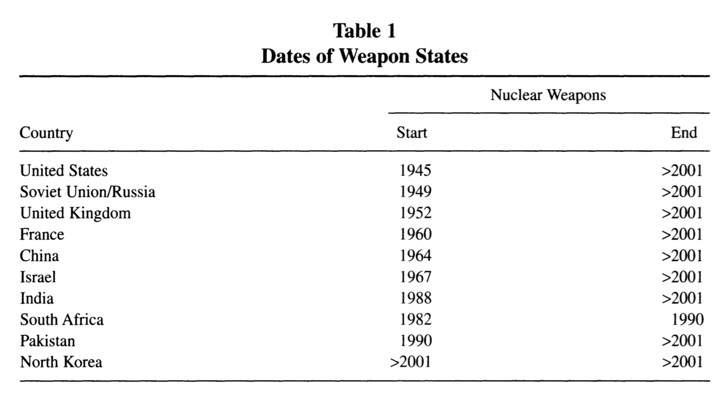
Winning with the bomb

Slide 10
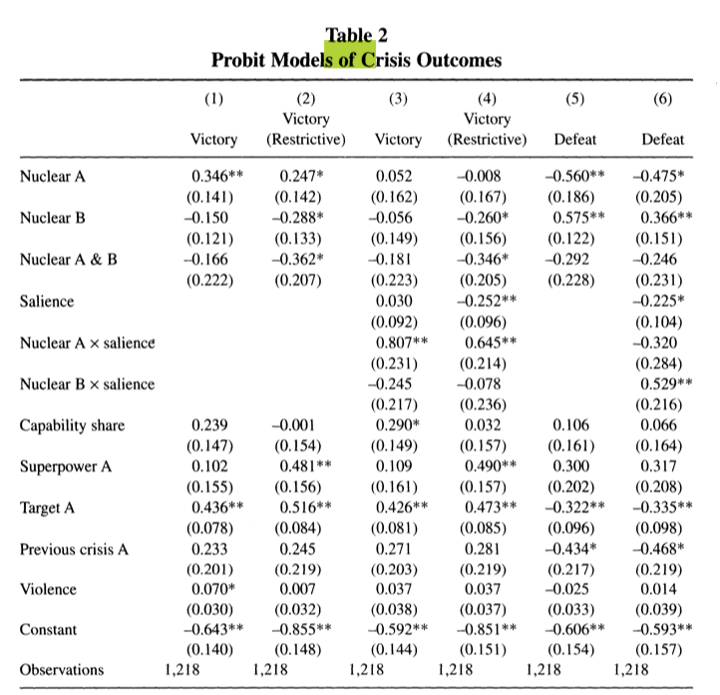
Winning with the bomb
1.) This table models the outcomes and salience of conflicts in both symmetric and asymmetric dyads.
2.) We see support for H1, H2, H3 and H5.
There is a relationship between nuclear status and the gaining of concessions in a crisis, as well as the duration of a crisis in an asymmetric dyad being lower than in a symmetric dyad.
The advantage of nuclear weapons bargaining only seems to hold in asymmetric dyads, and more salient crises boosts the relationship between nuclear status in an asymmetric dyad and ability to win and/or extract concessions from the nonnuclear adversary.

Slide 11
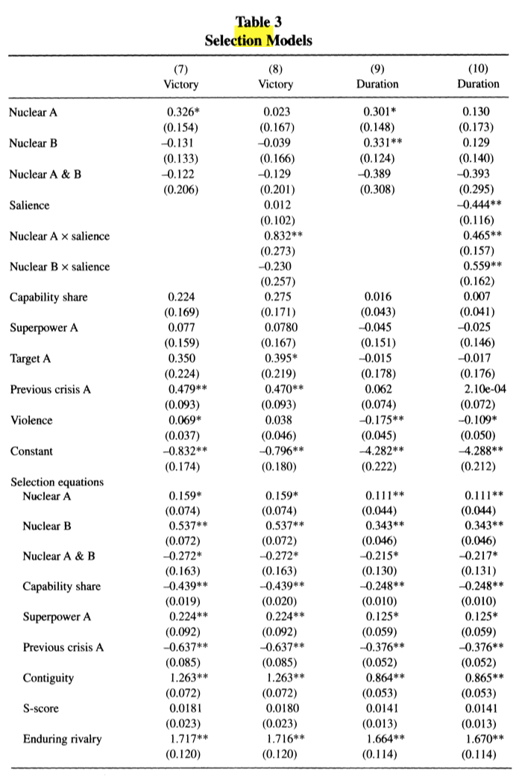
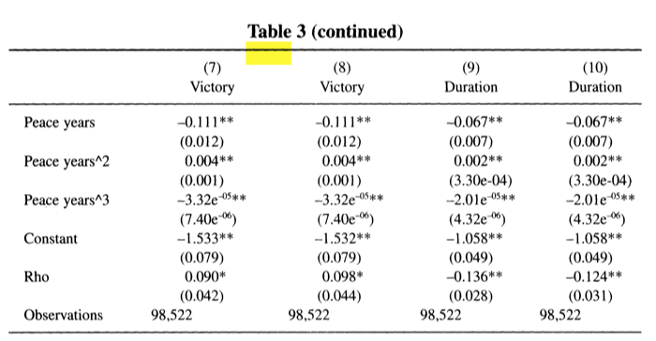
Winning with the bomb
1.) This table mainly focuses on salience (severity of the crisis) and its effect on duration of the conflict.
2.) It broadly demonstrates support for H2 and H4.
We can say with some confidence that nonnuclear actors in asymmetric dyads are more likely to end the conflict sooner, and that actors in symmetric dyads (both nuclear) are less likely to end the conflict sooner.

Slide 12
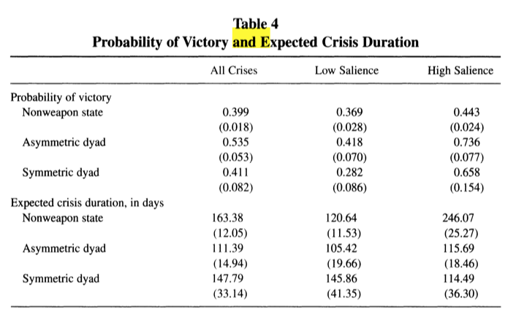
Winning with the bomb
1.) This table examines the probability of victory and expected crisis duration under various levels of salience for symmetric vs. asymmetric dyads.
There is evidence to suggest that introducing a nuclear actor significantly reduces the duration of a conflict (115 and 114 days vs. 246 days).
However, the expected crisis duration in both a symmetric and asymmetric dyad is nearly identical, indicating that that nuclear and nonnuclear opponents of nuclear states are more willing to give in during a crisis.
We also see more evidence to support the importance of saliency in a nuclear state’s chances of victory in an asymmetric dyad.

Slide 13
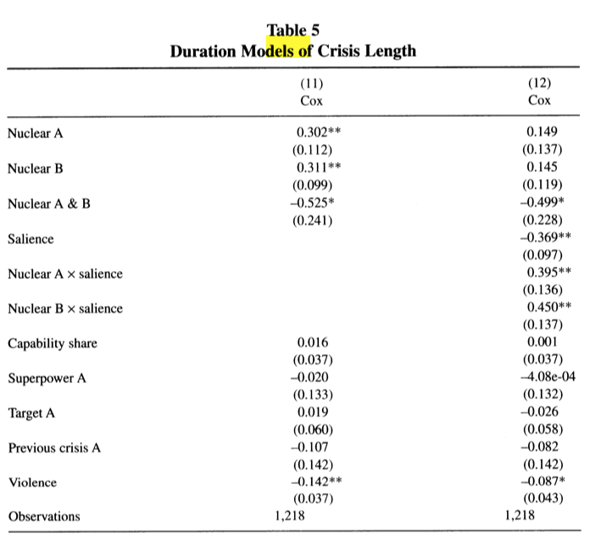
Winning with the bomb
1.) This table directly compares a variety of factors with crisis length, though I was somewhat unsure of how exactly to interpret all of the data.
We see support for H5 in model 12 regarding salience.
We also see support for H4 in model 12 (Nuclear A & B).
Thus, there is evidence here to suggest that salience has a strong effect on the duration of conflict in an asymmetric dyad.
We can also say that opponents of nuclear weapons states in symmetric dyads are probably less likely to end the conflict sooner.

Slide 14
Winning with the bomb
Conclusions:
Nuclear weapons give a significant advantage in asymmetric dyads, particularly if salience is high, in terms of chances of victory, gaining concessions and duration.
Nuclear weapons do not generally give a significant advantage in symmetric dyads.
What are some alternative explanations for these results?
Perhaps nuclear states tend to be allies of the United States (influence).
How long has the state had the capability?
On page 297, the article quotes George Shultz in saying that “proliferation begets proliferation” (Beardsley, Asal 297). Explain the reasoning behind this phrase and some problems associated with it.

Slide 15
Nuclear Superiority And The Balance Of Resolve:
Explaining Nuclear Crisis Outcomes
What is the general idea behind this article?
We want to know what determines the outcome of a nuclear crisis with regard to comparative nuclear arsenal size.
Nuclear Brinkmanship Theory
Strategic Nuclear Balance
The article combines both NBS and Strategic Nuclear Balance into one theory.

Slide 16
Nuclear Superiority And The Balance Of Resolve:
Explaining Nuclear Crisis Outcomes
More specifically…
The article argues that, between two nuclear armed states (a symmetric dyad), the state with the larger nuclear arsenal has a higher chance of achieving victory and gaining concessions in the conflict.
Nuclear superiority vs. Crisis Outcomes.
Mutually Assured Destruction
Second Strike Capability is based on nuclear armament size and development.

Slide 17
Nuclear Superiority And The Balance Of Resolve:
Explaining Nuclear Crisis Outcomes
Kroenig makes two main assumptions/insights as the core of his argument:
1.) Not all nuclear wars are equally devastating and this is important in the conflict bargaining process because states are constantly assessing the potential costs of escalation and their opponent’s secondary strike capability.
2.) Nuclear superiority reduces the expected costs of a country in the event of a nuclear war because it allows you to more effectively neutralize your enemies nuclear weapons infrastructure and capability. Therefore, an imbalance can make nuclear war more costly for one actor than another.
How does this relate to nuclear brinkmanship?

Slide 18
Nuclear Superiority And The Balance Of Resolve:
Explaining Nuclear Crisis Outcomes
H1:
States that enjoy nuclear superiority will be more likely to win a nuclear crisis.
H2:
The greater a state’s level of nuclear superiority, the more likely it is to win nuclear crises.
What are some possible explanations for these hypotheses?

Slide 19
Nuclear Superiority And The Balance Of Resolve:
Explaining Nuclear Crisis Outcomes
Independent Variable:
Does the country have superior nuclear superiority? If so, how superior?
Dependent Variable:
Outcome -> Does the country in question achieve victory and gain concessions in the nuclear crisis?

Slide 20
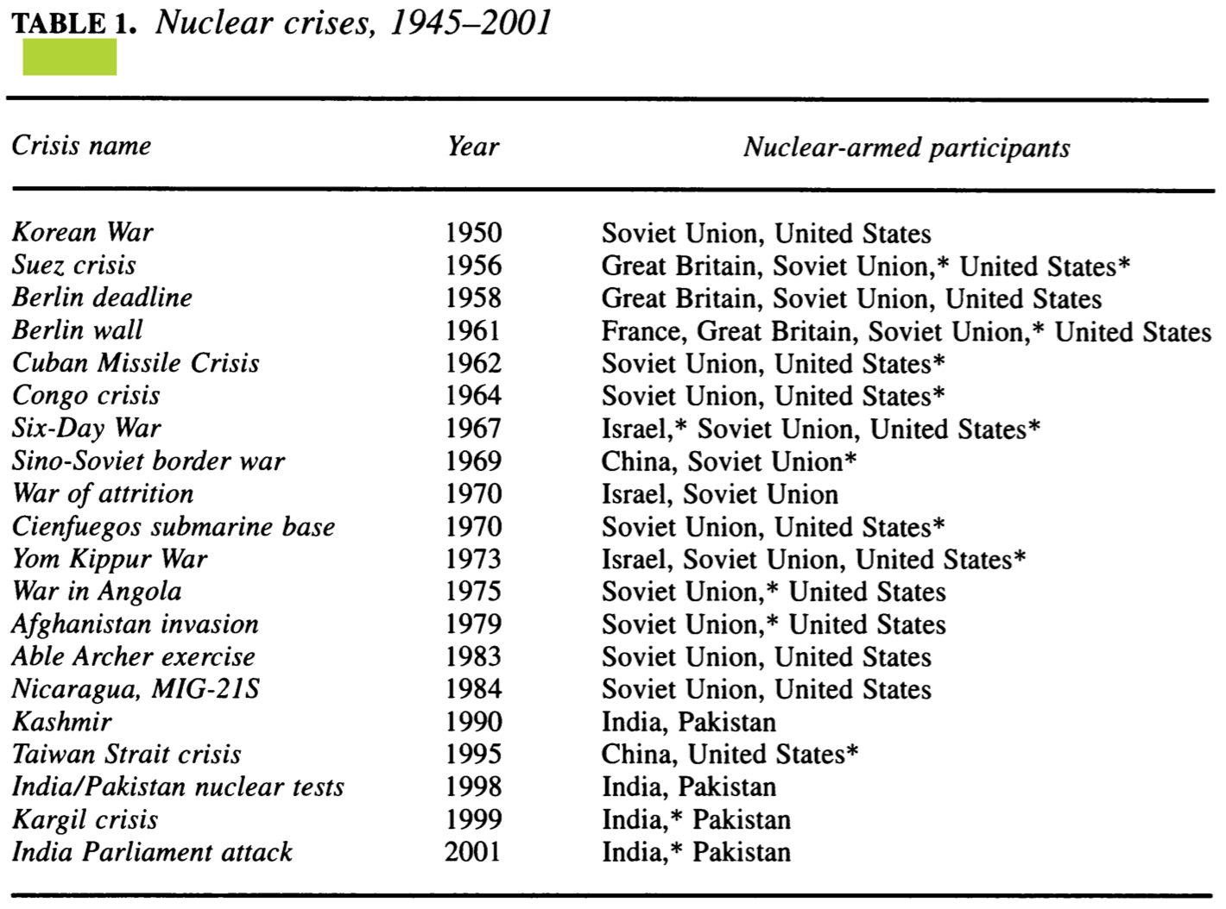
Nuclear Superiority And The Balance Of Resolve:
Explaining Nuclear Crisis Outcomes
1.) This table details nuclear crises from the end of World War II to 2001. Asterisks indicate the winner of the conflict.

Slide 21
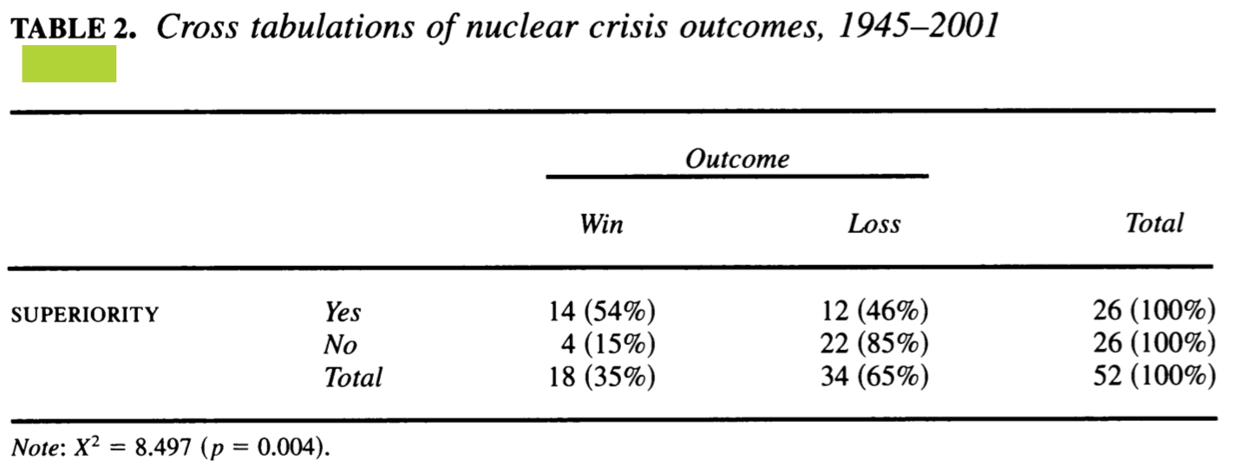
Nuclear Superiority And The Balance Of Resolve:
Explaining Nuclear Crisis Outcomes
1.) This table shows the results when comparing two nuclear but asymmetric nations in terms of wins and losses from the previous chart.
There is clear support for H1, because a superior nuclear arsenal supports victory in the nuclear crisis in 54% of cases, versus 85% loss with nuclear inferiority.

Slide 22
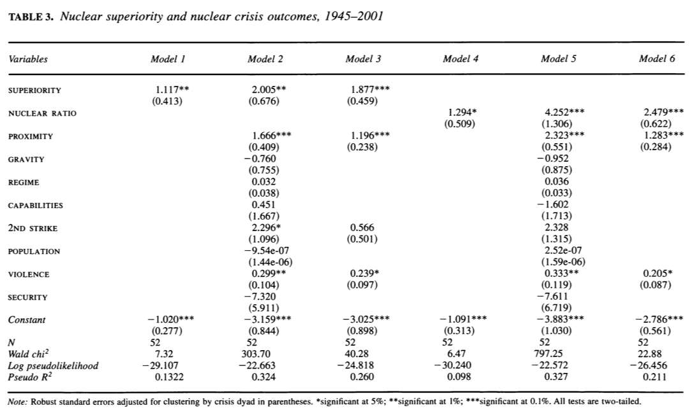
Nuclear Superiority And The Balance Of Resolve:
Explaining Nuclear Crisis Outcomes
1.) The table tests whether moving from nuclear inferiority to nuclear superiority correlates to an improved chance of winning the nuclear crisis in addition to some other variables (regime, proximity, etc).
Nuclear superiority gives one a 64% chance of winning the conflict alone.
Moving from nuclear inferiority to nuclear superiority increases the chance of winning the conflict by 57%.

Slide 23
Nuclear Superiority And The Balance Of Resolve:
Explaining Nuclear Crisis Outcomes
Other variables tested for an effect on nuclear outcome:
Proximity
Gravity
Regime
Secondary Strike Capability
What effect might these other variables have on the nuclear crisis bargaining process?

Slide 24
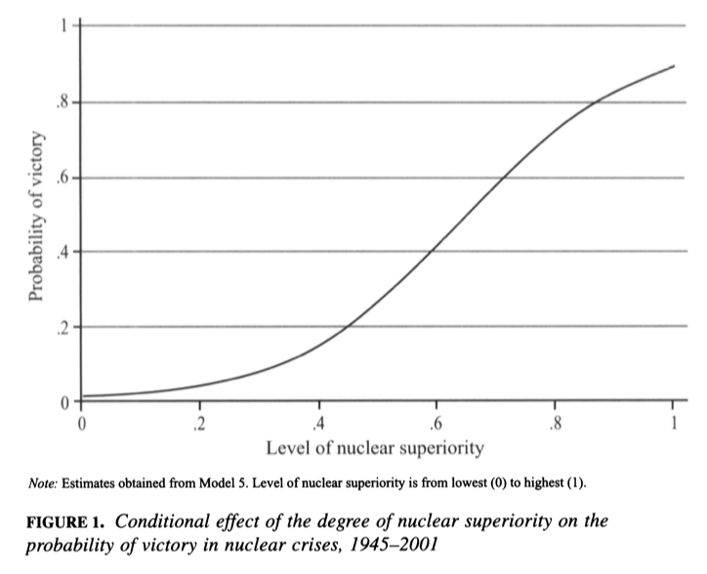
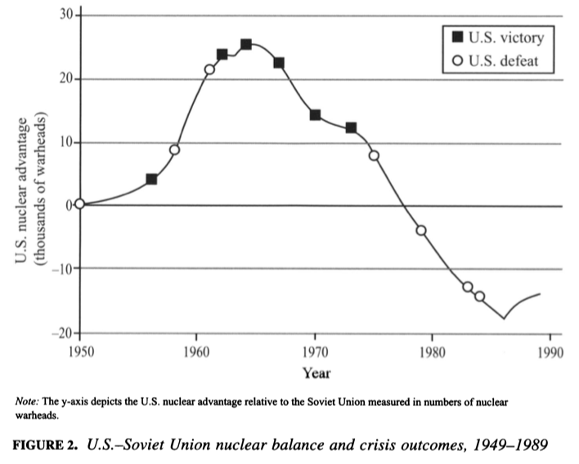
Nuclear Superiority And The Balance Of Resolve:
Explaining Nuclear Crisis Outcomes

